Slide 1
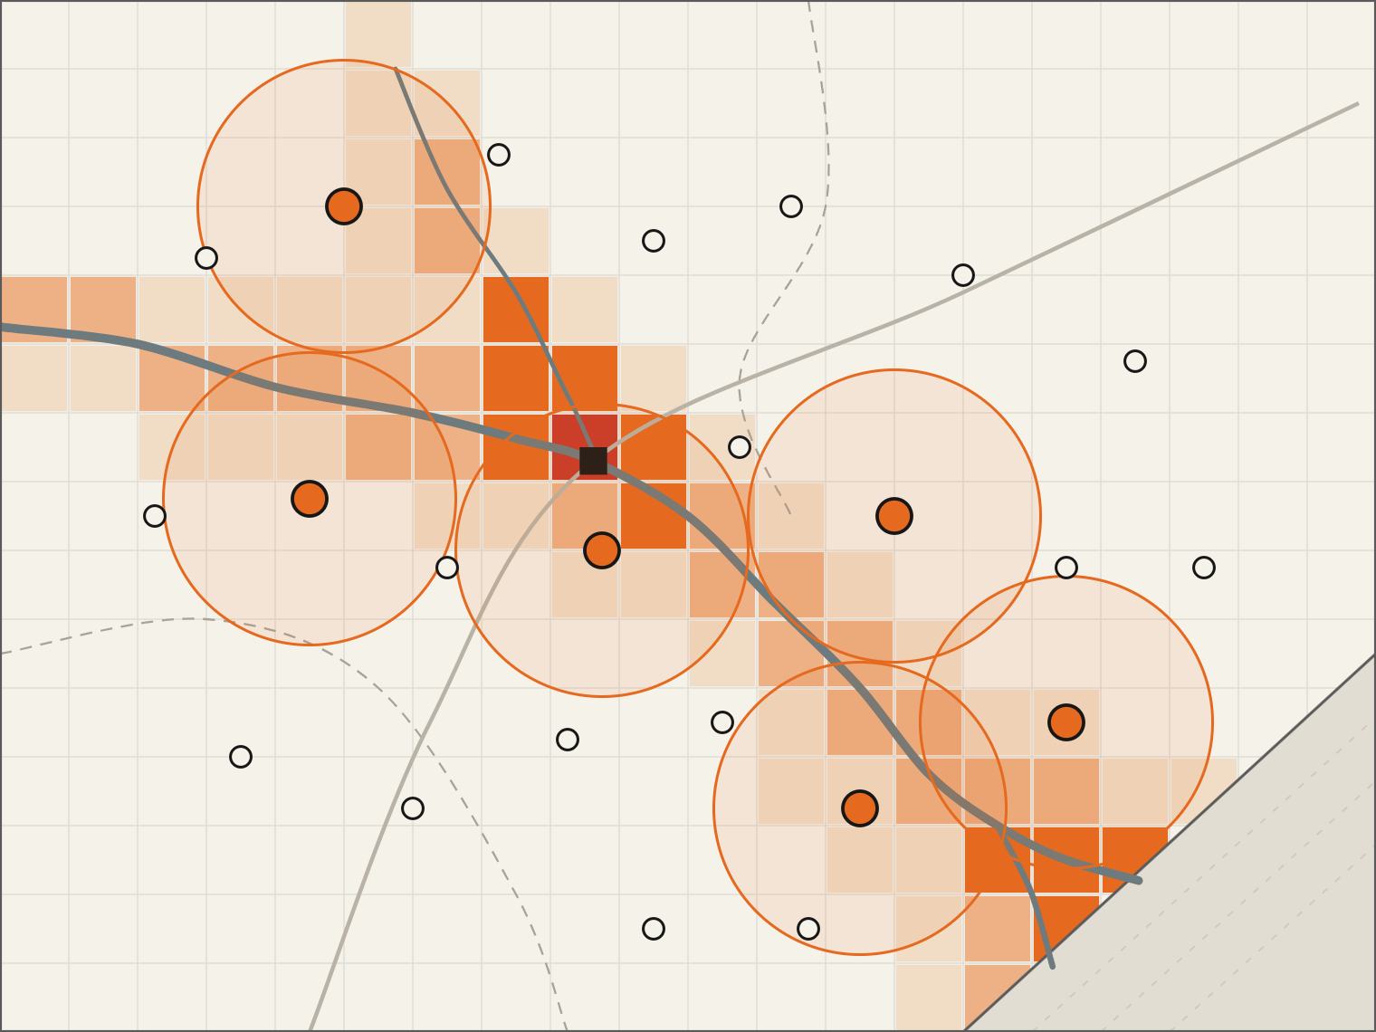
Budameru
QAIC use cases UC-067 · UC-077
Krishna
Quantum-Assisted Disaster Response Optimization
Vijayawada
Classical ML scores flood risk. QAOA on IBM Quantum decides where sensors and relief go, and re-decides when conditions change.
Bay of Bengal
Kala Dhua · Ayush Pathak | Shreeviraj Matale | Tushar Singh
Quantique Hackathon · Amaravati Quantum Valley
Notes:
Open on the map. This is the Krishna river at Vijayawada, the same place that flooded in September 2024. The coloured cells are flood risk from our ML model; the orange circles are where our QAOA run on IBM Quantum hardware decided to place sensors and relief units. One sentence pitch: classical ML tells us where the risk is, a quantum optimiser decides where help goes, and the loop re-runs whenever conditions change. We address UC-067 (flood forecasting and disaster-response sensor placement) and UC-077 (disaster-management resource optimisation) from the QAIC compendium.

Slide 2
01 · Problem
Coastal Andhra faced two major disasters in 14 months
Vijayawada floods · Sept 2024
Cyclone Montha · Oct 2025
29 cm
6.4 lakh
₹6,384 cr
rain in one day
people affected
revised state loss estimate
35
190
87,000 ha
38,000
deaths, NTR district
relief camps opened
crops damaged
people evacuated
Budameru rivulet peak flow vs its diversion canal capacity (m³/s)
990 observed
200 design capacity · 4.9× exceeded
Quantum-Assisted Disaster Response Optimization
02 / 15
Notes:
Two events, fourteen months apart, same coast. September 2024: 29 cm of rain in a day around Vijayawada; the Budameru rivulet peaked near 990 cubic metres per second against a diversion canal built for 200. About 6.4 lakh people were affected, 35 died in NTR district, 190 relief camps opened. October 2025: Cyclone Montha made landfall near Narasapuram; the state revised its loss to 6,384 crore rupees, 87,000 hectares of crops damaged, 38,000 people evacuated. Sources: Wikipedia summaries of state situation reports; Outlook India / Deccan Herald for the Montha estimate. The point: forecasts existed. The bottleneck is deciding, fast, where sensors, teams and supplies go.

Slide 3
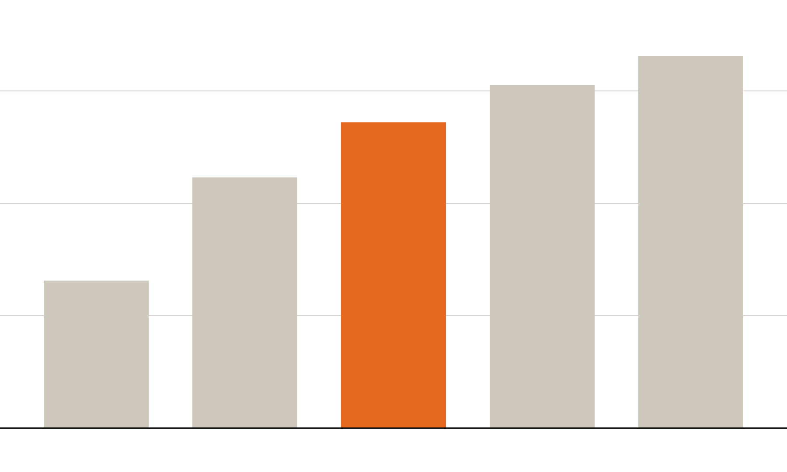
02 · Why it is hard
Deciding where help goes is a combinatorial problem
Ways to place 10 units among n candidate sites (log scale)
17 trillion
1.6 trillion
75 billion
848 million
75 billion
185 thousand
plans for 10 teams across 60 sites
Coverage overlaps make sites interdependent
Risk moves as rain and river levels change
A plan made at T0 is stale hours later
Maps directly to a QUBO: binary choice per site
n = 20
n = 40
n = 60
n = 80
n = 100
Quantum-Assisted Disaster Response Optimization
03 / 15
Notes:
Placement is a subset-selection problem. With 60 candidate sites and 10 teams there are about 75 billion possible plans, and every extra site multiplies that. Sites interact: two sensors side by side waste coverage, so you cannot score them one at a time. And the input changes during the event. This is exactly the structure a QUBO captures: one binary decision per site, pairwise interaction terms for overlap. That is why we chose quantum optimisation for this stage and not for the forecasting stage. Numbers are exact binomial coefficients C(n,10).

Slide 4
03 · Market
Disaster response is a large, publicly funded market
$196B
$3.3B
₹2.29L cr
$43–71B
Incident & emergency management, 2030
Flood warning systems, 2035
India disaster funds, 15th FC 2021–26
Quantum computing revenue, 2035
2025: $1.67B
CAGR 6.9%
2024: $137.5B
CAGR 6.1%
SDRF + SDMF + NDRF + NDMF
3.7× the 14th FC
2025: >$1B
Investment 2025: $12.6B
Market Research Future
MarketsandMarkets
PIB, MHA
McKinsey QTM 2026
$7.6B
India’s losses to floods and storms in 2021 alone, second-highest in Asia (WMO State of the Climate in Asia)
Quantum-Assisted Disaster Response Optimization
04 / 15
Notes:
Market sizing, all third-party figures. Incident and emergency management: 137.45 billion dollars in 2024 to 196.2 billion by 2030 (MarketsandMarkets, 6.1 percent CAGR). Flood warning systems alone: 1.67 billion in 2025 to 3.27 billion in 2035 (Market Research Future, 6.9 percent). In India the buyer is government: the 15th Finance Commission allocated about 2.29 lakh crore rupees across state and national disaster response and mitigation funds for 2021-26, versus 61,220 crore in the previous cycle. On the quantum side, McKinsey's 2026 monitor puts quantum computing revenue above 1 billion dollars in 2025 and 43 to 71 billion by 2035. And the cost of doing nothing: 7.6 billion dollars of flood and storm losses in India in 2021 (WMO). Our entry point is the state disaster management authority, which already holds the budget line.

Slide 5
04 · Landscape
Forecasting is well served; response placement is not
Approach | Forecasts risk | Plans placement | Re-plans live | Uses quantum
Google Flood Hub | Yes, 7-day | No | No | No
CWC / IMD forecasts | Yes | No | No | No
Manual control-room planning | No | Yes, by hand | Partial | No
Classical MILP solvers | No | Yes | Partial | No
NQCC × Mind Foundry PoC (UK) | No | Yes | Not reported | Yes
This project | Yes | Yes | Yes | Yes, IBM QPU
Flood Hub covers 460M people in 80+ countries but stops at the forecast. The UK NQCC funded a quantum sensor-network PoC for disaster response in 2025, which validates the direction. We close the loop: risk → placement → re-placement.
Quantum-Assisted Disaster Response Optimization
05 / 15
Notes:
Where we sit. Forecasting is crowded and good: Google Flood Hub gives 7-day riverine forecasts to about 460 million people; CWC and IMD run India's official forecasts. None of them decide where to put sensors, teams or supplies; that is done by hand in control rooms or, at best, with a classical MILP solver re-run manually. The closest prior art is the UK National Quantum Computing Centre's 2025 SparQ project with Mind Foundry on quantum optimisation for in-field sensor networks in disaster response, so the problem framing is credible to the quantum community. Our difference: the forecast feeds the optimiser automatically and the optimiser re-runs on quantum hardware whenever the forecast changes.

Slide 6
05 · System
One pipeline from disaster map to deployed plan
Quantum stages
01
02
03
04
05
06
07
Disaster map
Risk model
QUBO
QAOA circuit
IBM QPU
Placement
Adaptation
IMD · SRTM · OSM
XGBoost classifier
Qiskit, Ising form
Qiskit, p = 1–2
Heron · Runtime
Decoded bitstring
Event trigger
Re-run when rainfall, river level or road status crosses a threshold
Classical where classical is strong: forecasting. Quantum where the problem is combinatorial: choosing sites.
Quantum-Assisted Disaster Response Optimization
06 / 15
Notes:
The whole system on one line. 01: we build a gridded map of the region from IMD rainfall, SRTM elevation and OpenStreetMap roads and settlements. 02: a gradient-boosted classifier turns that into a risk score per cell. 03: we convert the placement decision into a QUBO. 04: Qiskit builds the QAOA circuit. 05: the circuit runs on an IBM Heron QPU through Qiskit Runtime. 06: the best bitstring decodes into a placement on the map. 07: when inputs cross a threshold, the loop re-runs from the risk model. The dashed orange box marks the three quantum stages; everything else is classical, on purpose.

Slide 7
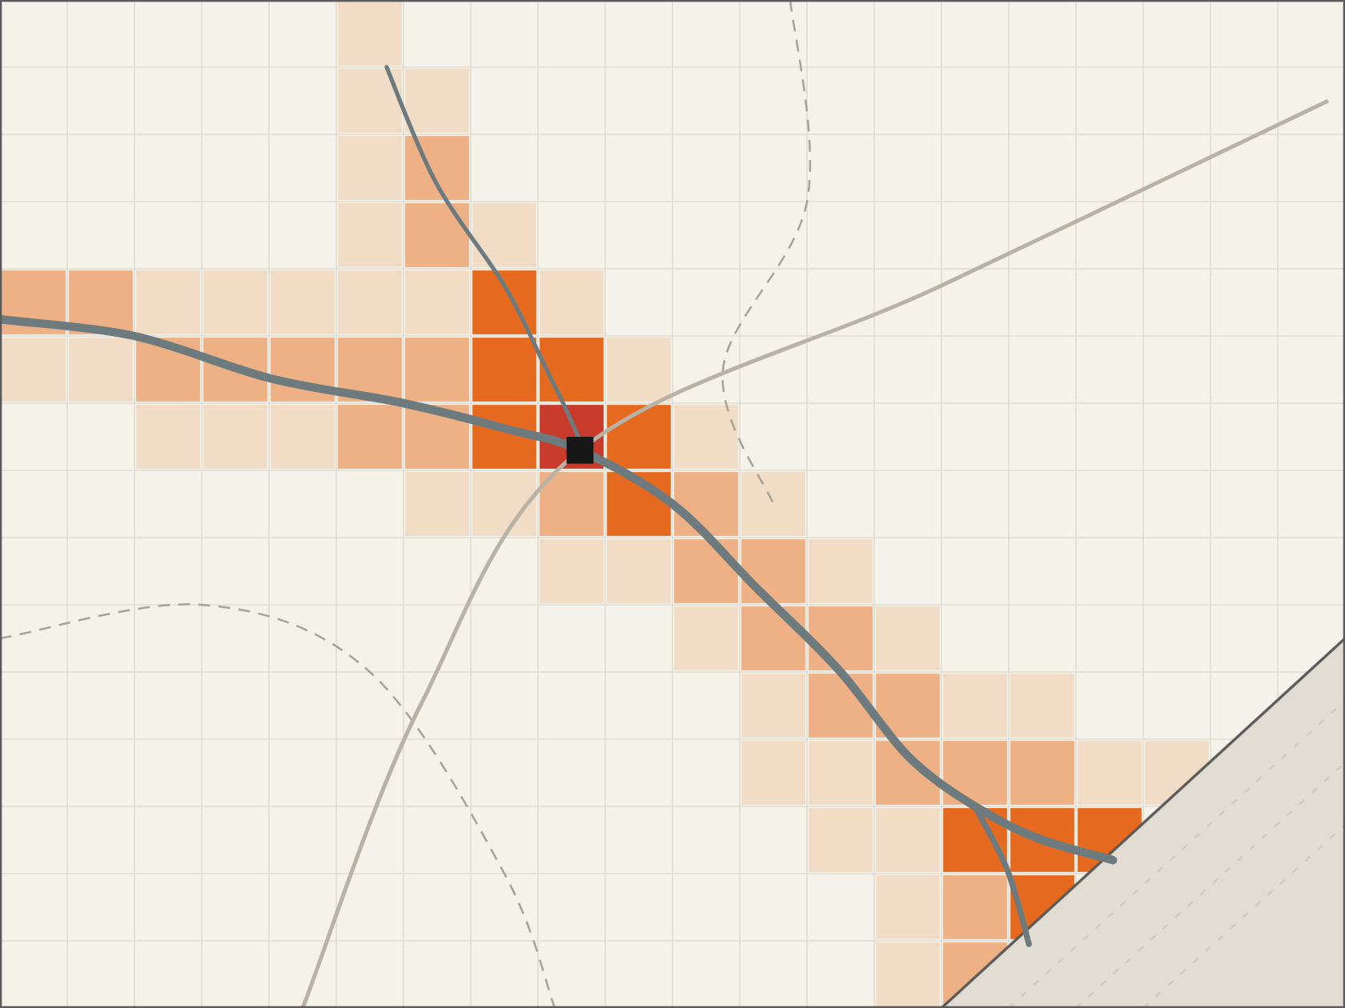
06 · Stage 1 — classical ML
A risk score for every grid cell
Inputs: IMD gridded rainfall, SRTM elevation, river distance, land use
Labels: Sentinel-1 flood extents from past events, incl. Sept 2024
Model: gradient-boosted trees, 1 km cells, spatial cross-validation
Output: risk × population = weight w_i per candidate site
Vijayawada
Low
Moderate
High
Severe
Bay of Bengal
Quantum-Assisted Disaster Response Optimization
07 / 15
Notes:
Stage one is deliberately classical. Gradient-boosted trees are strong on tabular geospatial data and quick to retrain; there is no reason to use a quantum model here. Inputs: IMD gridded rainfall, SRTM elevation, distance to river, land use. Labels: flood extents mapped from Sentinel-1 radar for past events including the September 2024 flood. We validate with spatial cross-validation so the model is not just memorising neighbouring cells. The output that matters downstream is a weight per candidate site: expected risk-weighted population that site would cover. The map shows the risk layer the optimiser sees. [Replace this map with your trained model output before submission.]

Slide 8
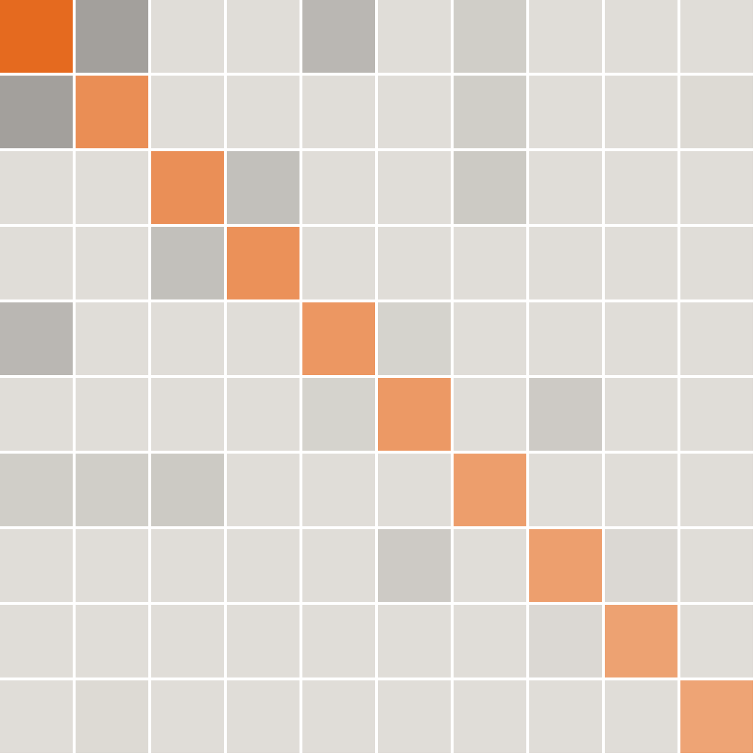
07 · Stage 2 — formulation
Placement becomes a QUBO: one qubit per candidate site
min f(x) = − Σ w_i·x_i
+ λ1 Σ o_ij·x_i·x_j
+ λ2 (Σ x_i − k)²
x_i ∈ {0,1} · x_i = (1 − z_i)/2 → Ising H_C
w_i risk-weighted population site i covers
o_ij coverage overlap between sites i and j
k sensors or teams available; λ tuned so k holds
Built with Qiskit Optimization; checked by exact solver
Reward (diagonal)
Penalty
Quantum-Assisted Disaster Response Optimization
08 / 15
Notes:
Stage two. Each candidate site gets a binary variable, which becomes one qubit. The objective rewards covering risk-weighted population, penalises overlap between two chosen sites, and a quadratic penalty enforces exactly k units. Substituting x = (1 - z)/2 gives an Ising Hamiltonian, which is what QAOA optimises. The heat map is a real 10-site QUBO from our pipeline: the orange diagonal is reward, grey off-diagonals are overlap plus the cardinality penalty. We tune lambda so every low-energy state respects k, and verify small instances against an exact classical solver before sending anything to hardware.

Slide 9
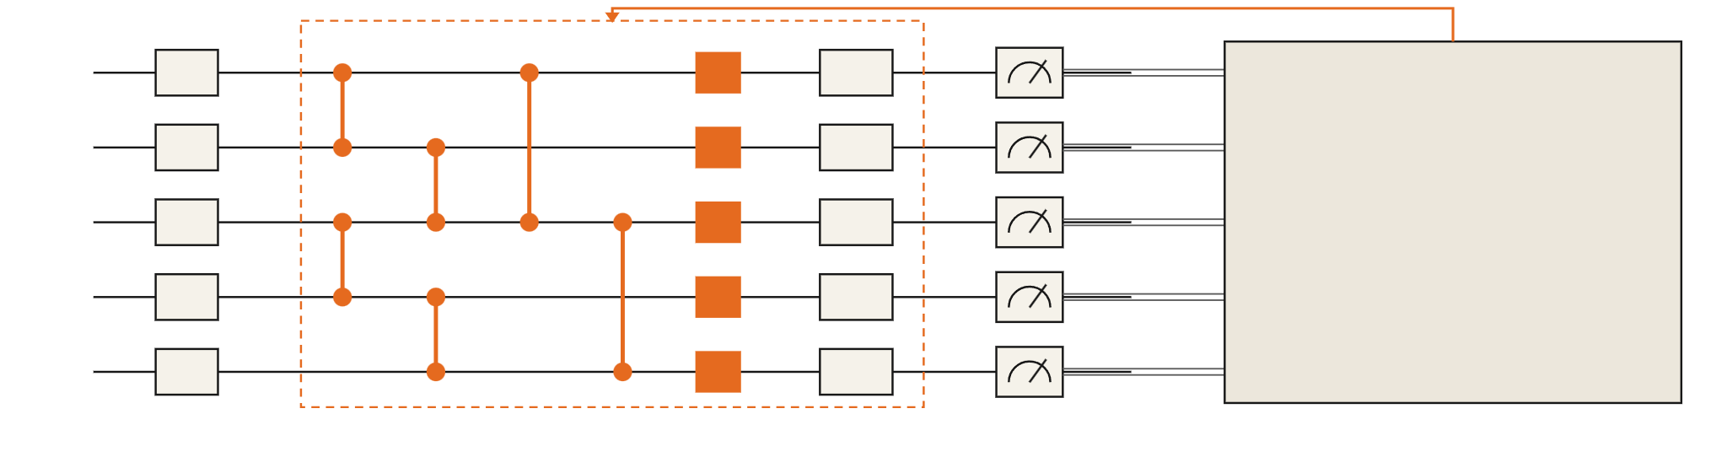
08 · Stage 3 — quantum
QAOA searches the placement space on the QPU
× p layers, p = 1–2
q0
q1
Classical optimiser
COBYLA on CVaR of sampled energies; returns new γ, β
q2
q3
q4
Hadamard
Cost e^(−iγH_C)
Mixer e^(−iβH_B)
Measure
Cost layer encodes the QUBO: ZZ for overlaps, Z for site rewards
Mixer moves amplitude between placements
Warm start reuses γ, β from the last run when inputs change
Quantum-Assisted Disaster Response Optimization
09 / 15
Notes:
Stage three. Start in an equal superposition of every placement. The cost layer applies phase rotations from the QUBO: two-qubit ZZ rotations for overlaps, single-qubit Z rotations for the site rewards. The mixer layer applies X rotations so amplitude can flow between placements. We repeat that p times, with p equal to 1 or 2 because deeper circuits drown in noise on today's hardware. We measure, compute the conditional value-at-risk of the sampled energies, which focuses on the best samples rather than the mean, and a classical optimiser, COBYLA, picks new angles. The key design choice for our adaptive system: when conditions change we warm-start from the previous angles, so re-optimisation needs far fewer QPU iterations.

Slide 10
09 · Execution
Running on IBM Heron, engineered for noise
01
Qiskit
156
QuadraticProgram → Ising operator
Decompose
qubits on IBM Heron r2, the same class as Amaravati’s System Two
02
Split region into ≤20-qubit subproblems
03
Transpile
≤20
ISA circuit for heavy-hex, noise-aware layout
04
Qiskit Runtime
qubits per subproblem: our design bound for usable fidelity
Sampler V2, batch mode
05
IBM Heron QPU
Real hardware via IBM Quantum Platform
20,000+
06
Mitigate & decode
two-qubit gates when large QAOA is transpiled naively, noise-dominated (arXiv 2607.11637)
Dynamical decoupling, Pauli twirling, CVaR
Quantum-Assisted Disaster Response Optimization
10 / 15
Notes:
How the quantum stage actually runs. Qiskit converts the QUBO to an Ising operator. We decompose the region into subproblems of at most about 20 qubits, because a July 2026 benchmark on IBM Heron found naive QAOA on larger problems transpiling to over 20,000 two-qubit gates and results indistinguishable from random. Each subproblem is transpiled to an ISA circuit with a noise-aware layout on the heavy-hex lattice, then submitted with Qiskit Runtime's Sampler V2 in batch mode, which works on the free Open Plan. We turn on dynamical decoupling and Pauli twirling, and aggregate with CVaR. Heron r2 is the 156-qubit processor class IBM is commissioning at Amaravati, targeted for September 2026, so the same code runs on sovereign hardware.

Slide 11
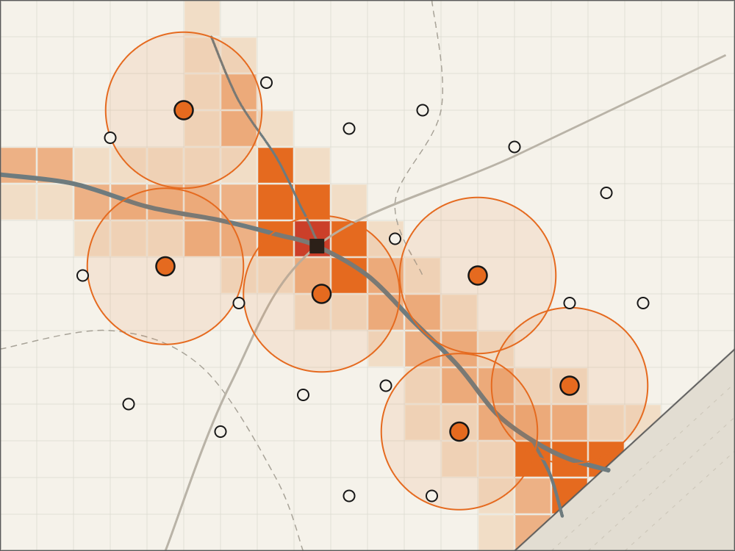
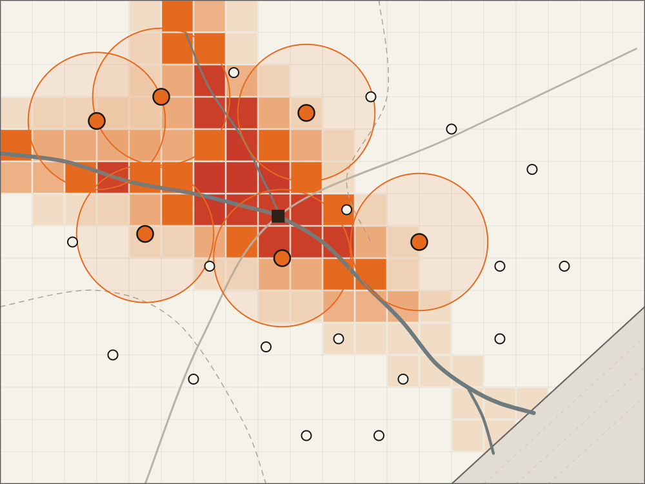
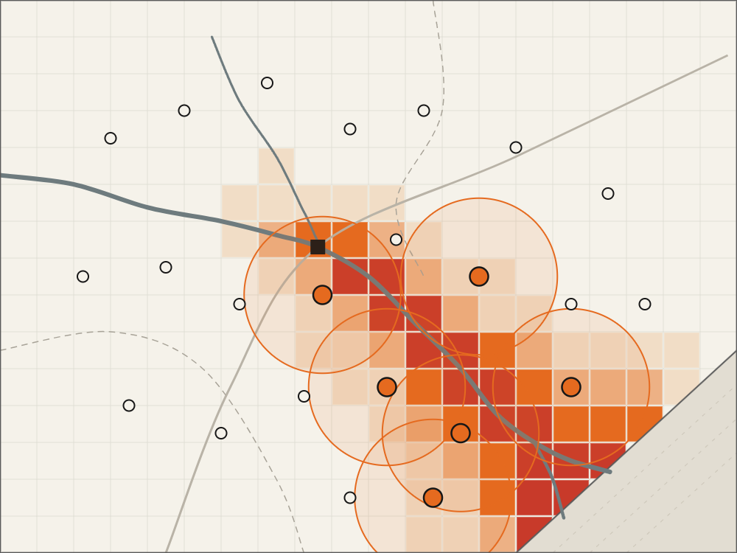
10 · Adaptation
The plan follows the flood as it moves
T0 · forecast issued
T+6 h · Budameru surge
T+12 h · delta flooding
Baseline risk; initial solve
Risk shifts north; sites re-solved
Delta at risk; sites re-solved
Trigger: new rainfall, gauge or road data past a threshold
Local re-solve: only subregions whose risk changed go back to the QPU
Warm start: previous γ, β cut optimiser iterations
Quantum-Assisted Disaster Response Optimization
11 / 15
Notes:
This is what makes it a system, not a one-off solve. At T0 the forecast gives a baseline and we place six units. Six hours later the Budameru catchment surges, the risk layer shifts north, and the optimiser moves units toward it. By T plus 12 hours the water is in the delta and the plan follows. Three mechanisms keep this fast and cheap on QPU time: an event trigger so we only re-run when inputs actually change; local re-solving so only the affected subregions go back to the hardware; and warm-starting QAOA from the previous angles. The three maps are the same pipeline run on three risk states; in the demo video this is a live replay. [Replace with your recorded replay frames.]

Slide 12
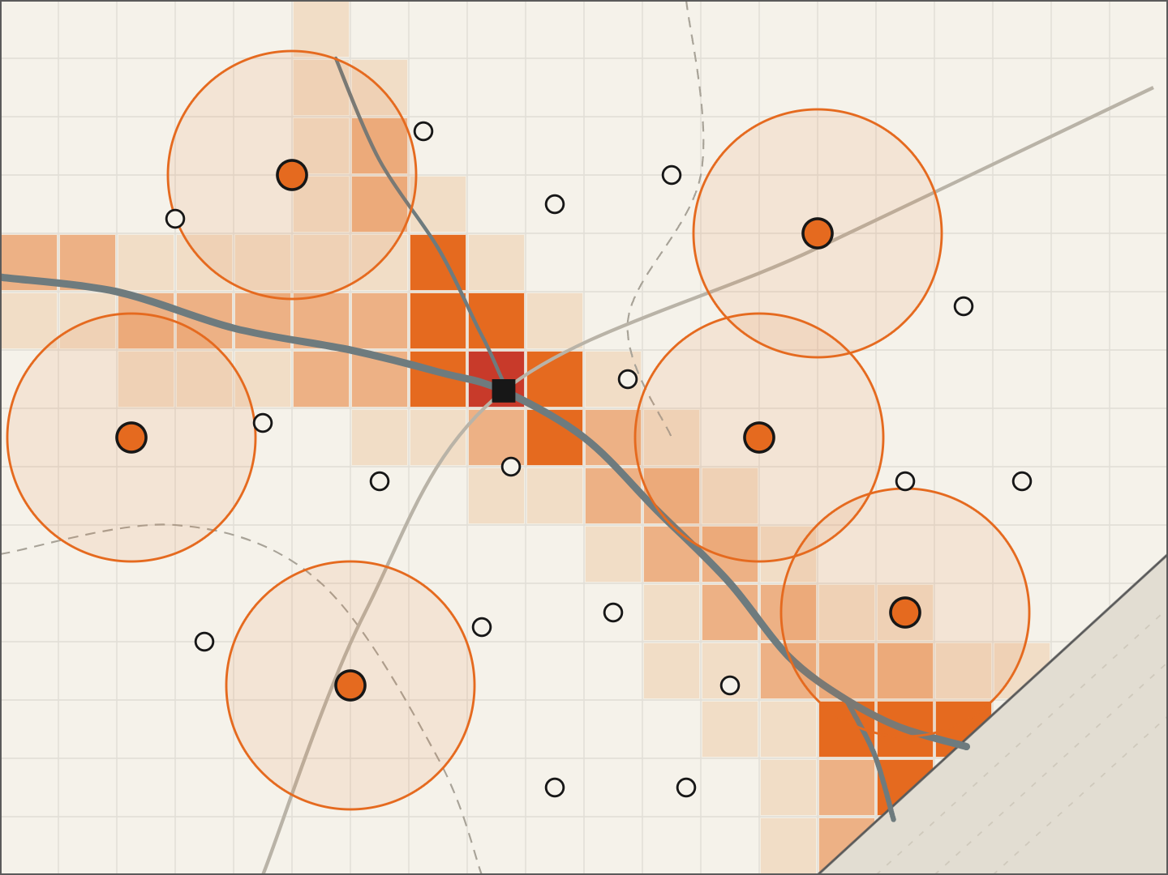

11 · Result
Same six units, placed where the risk is
Before: uniform spacing
Baseline
After: QAOA on IBM Heron
Optimised
High-risk pop. covered: [__]%
High-risk pop. covered: [__]% · ratio [__]
Quantum-Assisted Disaster Response Optimization
12 / 15
Notes:
Before and after on the same map and the same six units. Left: a uniform spacing, which is roughly what a static plan drawn in advance looks like; several units sit on low-risk ground. Right: the placement decoded from our QAOA run on IBM hardware, concentrated on Vijayawada, Budameru and the delta. Report three numbers here from your own runs: share of high-risk population covered for each, the approximation ratio of the hardware result against the exact classical optimum, and the share of hardware shots that were feasible, meaning exactly k units. [Fill the bracketed values from your benchmark notebook; do not estimate them.] Also show the classical baselines, greedy and exact MILP, in the video; judges will ask.

Slide 13

12 · Demo
The operator view: a map, a QPU job, a plan
Q-ADR console · Krishna basin
● IBM Quantum connected
QPU job
Event
Budameru surge · T+6 h
Backend
ibm_[backend] · Heron r2
Subproblems
[__] × ≤20 qubits
Shots
[__] per circuit
QPU time
[__] s
Status
Complete
6 units re-assigned · plan pushed to field teams
1
Load live event
2
Score risk
3
Solve on the QPU
4
Re-plan on update
Quantum-Assisted Disaster Response Optimization
13 / 15
Notes:
This is the screen the video walks through. Left: live risk map with current placement. Right: the QPU job for this update: backend name, number of subproblems, shots, QPU seconds and status. The four steps along the bottom are the video script: load an event, score risk, solve on the QPU, then inject a change and show the re-plan. Record the IBM Quantum Platform job page alongside so judges see the job IDs are real. [Fill backend, subproblem count, shots and QPU time from your actual run.]

Slide 14
13 · Fit and roadmap
Built for Andhra’s QPU, honest about its limits
What is new
Fit to QAIC
Honest limits
Closed loop: ML risk feeds QAOA automatically
Event-triggered, warm-started re-optimisation
Decomposition sized to real QPU fidelity
Solves UC-067 and extends to UC-077
Builds on DST-NQM proposals 03 and 04
Targets AQV’s IBM System Two
No quantum advantage claimed at this scale
Subproblems capped near 20 qubits by noise
Classical MILP stays the baseline and fallback
Now
Q4 2026
2027
Next
IBM Quantum cloud, Krishna basin prototype
Port to Amaravati IBM System Two
[Proposed] pilot with APSDMA control room
Cyclones (UC-077), multi-hazard, larger QPUs
Quantum-Assisted Disaster Response Optimization
14 / 15
Notes:
Three things to leave with. What is new: the closed loop, not any single component; ML risk automatically becomes a QUBO, the QUBO re-solves on quantum hardware whenever inputs change, and subproblem size is chosen from measured hardware fidelity. Fit: this is UC-067 directly and extends to UC-077; it builds on DST-NQM proposal 03 (quantum optimisation for mobility and logistics, IIT Hyderabad and IISER Tirupati) and 04 (QUEST climate modelling, with Andhra University), and it targets the IBM System Two being commissioned at Amaravati. Limits, stated plainly: we do not claim quantum advantage at 20 qubits; a classical MILP solves these instances today and remains our baseline and fallback. The value is a pipeline that is ready to scale as hardware improves. Roadmap dates after 'now' are proposals.

Slide 15
14 · Summary
Sources
1. Wikipedia, 2024 Vijayawada floods (state situation reports)
Forecasts say where the water goes. We decide where help goes.
2. Outlook India / Deccan Herald: Cyclone Montha loss ₹6,384 cr
3. WMO State of the Climate in Asia 2021, via Down To Earth
4. MarketsandMarkets, Incident & Emergency Management 2024–30
5. Market Research Future, Flood Warning System 2025–35
ML risk → QUBO → QAOA on IBM Heron → plan
Re-optimises automatically as the flood evolves
Ready for Amaravati’s own quantum computer
6. PIB (MHA): 15th Finance Commission disaster allocations
7. McKinsey Quantum Technology Monitor 2026
8. Google Flood Hub coverage figures
9. NQCC SparQ: Mind Foundry disaster sensor-network PoC
Demo video:
10. arXiv 2607.11637: QAOA benchmarks on IBM Heron
Code: officialayush23/QuantumHack
11. Quantum Computing Report: IBM System Two, Amaravati
Kala Dhua· officialayushp123@gmail.com
12. QAIC 100 Quantum Use Cases, UC-067 and UC-077
Demo link:
Quantum-Assisted Disaster Response Optimization
15 / 15
Notes:
Close on the one-line idea: forecasts tell you where the water goes; our system decides where help goes, on quantum hardware, and keeps deciding as the situation changes. Point to the demo video and repository. Sources for every figure in the deck are listed on the right.

